Slide 1
Aleppo – Syria
Church of Saint Simeon Stylites

Slide 24
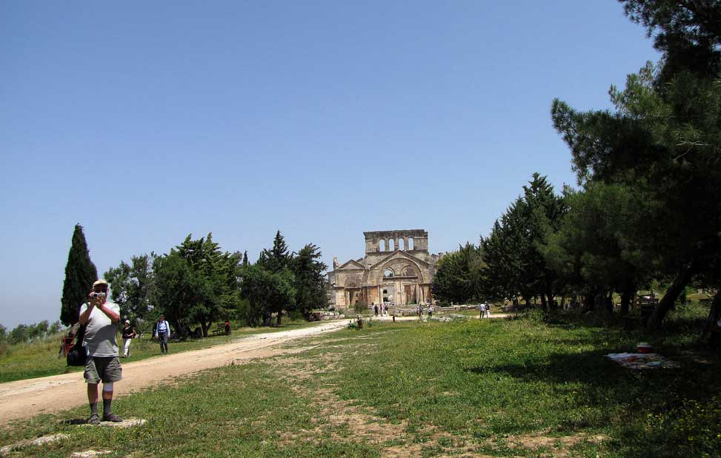
END
mcostiniuc
Personal Photo

