Slide 1
Syracuse
archaeological site

Slide 2
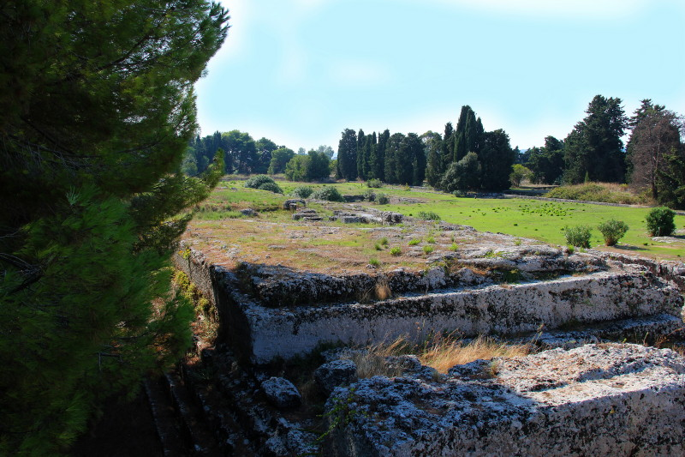

Slide 27
mcostiniuc
Personal Photo & arrangement

